Slide 1

Galip Tolga ERDEM

Slide 2

Motivation and Usage
Architecture
  Definiton of Pipes
  Definiton of Filters
Definiton of Pipeline
Expression on a sample Program
Benefits and Liabilities
References

Slide 3

Especially in many enterprise integration scenarios, a single event triggers a sequence of processing steps, each performing a specific function.
Furthermore, complex integrated processes such as OS kernels must be synchronized and integrated with each other for maximum efficiency and minimum resource consumption.

Slide 4

To overcome such demands and problems, Pipes and Filters Design Pattern is mostly used.
Pipes and Filters Pattern is an architectural style in which a process consists of a series of steps to be followed in order to proceed the data, and the output of one step is the input of another step.

Slide 5

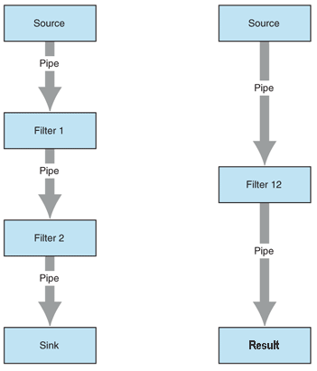
Source delivers a data stream
Filters process streams of data
A pipe delivers an (infinite) stream of data
Sink consumes a data stream
Result in the final processed output data

Slide 6

A pipeline consists of a chain of processing elements (processes, threads, etc..), arranged so that the output of each element is the input of the next.
Usually some amount of buffering is provided between consecutive elements. The information that flows in these pipelines is often a stream of records, bytes or bits.

Slide 7

Key Word in Context ;
is a classic problem in Software Engineering papers in which you try to create an index of words by sorting and aligning each word in a piece of text.

Slide 8

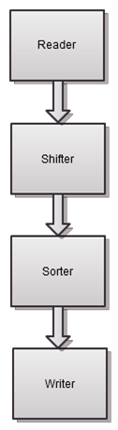
Reader: The Reader filter reads the input text from a file and returns an IEnumerable list of lines.
Shifter: The main logic of the application, it shifts the words in each line to find all the possible permutations suitable for the index.
Sorter: Swaps the words in the content .
Writer: Displays the final result after processes.

Slide 9
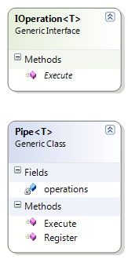
Generic Interface simulates the Filter
Generic Class simulates the pipeline

Slide 10

Improved reusability.
Improved performance.
Reduced coupling.
Improved modifiability.

Slide 11

Increased complexity.
Lowered performance due to communication overhead.
Increased complexity due to error handling.
Increased maintainability effort.

Slide 12

Thanks For Your Time

Slide 13

http://msdn.microsoft.com/en-us/library/ff647419.aspx
Enterprise Integration Patterns by Gregor Hohpe and Bobby Woolf
http://architects.dzone.com/news/pipes-and-filters-pattern-net
http://en.wikipedia.org/wiki/Pipeline(software)

